Slide 1

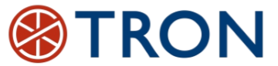

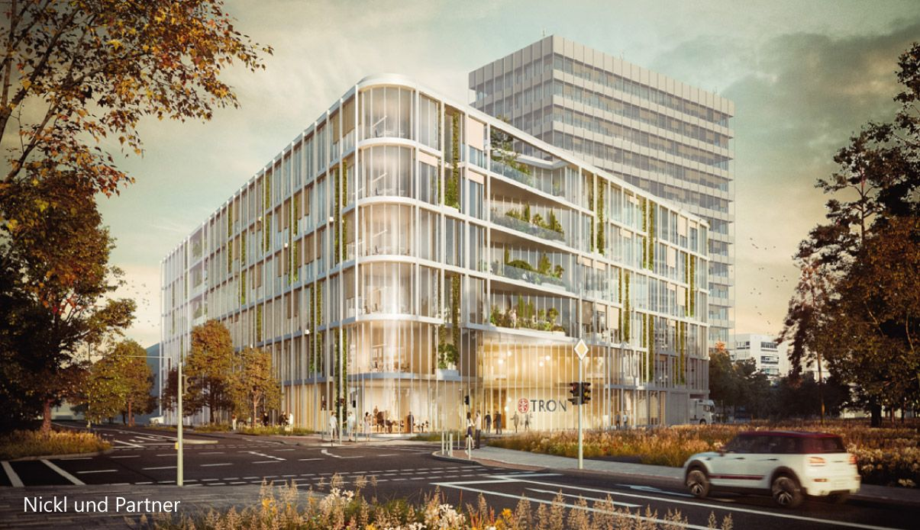
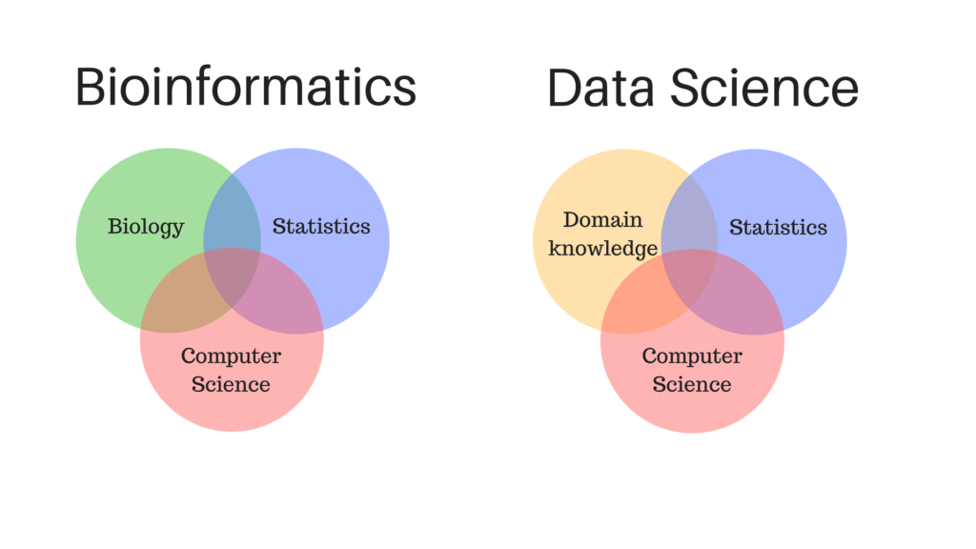
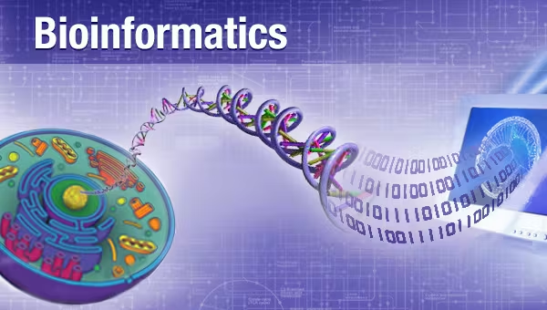
Introduction to Bioinformatics
Study program: Bioprocess Engineering
Elective Module (Wahlpflichtmodul)
9th October to 13th October
Responsible: Prof. Dr. Axel Blokesch, blokesch@fb2.fra-uas.de
by Pablo Riesgo-Ferreiro, TRON gGmbH
pablo.riesgoferreiro@tron-mainz.de
Day 1 - Session 2

Slide 2
Outline of session
Overview of NGS methods
Computational genomics pipelines
De novo assembly
Alignment
Variant calling (germline vs somatic, small vs structural)
RNA alignment
Gene expression and differential gene expression
Standard genomic data formats
Demos
VCF manipulation in the command line using bcftools
Visualizing different data formats in the Integrative Genomics Viewer (IGV)

Slide 3
Overview of NGS methods

Slide 4
Overview of NGS methods
Whole Genome Sequencing (WGS): This method sequences the entire genome of an organism.
Targeted Sequencing: This includes whole exome sequencing (WES) and gene or region-specific panels.
RNA Sequencing: This method sequences the RNA in a sample to study cellular responses.
Single-Cell NGS Methods:
Single-Cell DNA Sequencing: This involves isolating a single cell, amplifying the whole genome or region of interest, constructing sequencing libraries, and then applying next-generation DNA sequencing.
Single-Cell RNA Sequencing (scRNA-seq): This method sequences the RNA in a single cell, providing a higher resolution of cellular differences.
Epigenetic Approaches:
Methyl-seq: This method investigates the methylation status of the genome with single-nucleotide resolution.
ChIP-seq: This combines chromatin immunoprecipitation (ChIP) with NGS to identify binding sites of DNA-associated proteins throughout the genome.
ATAC-seq: An assay for transposase-accessible chromatin sequencing, this determines regions of chromatin accessibility and maps DNA binding proteins to identify active promoters, enhancers, and other cis-regulatory elements.
Immunoinformatics approaches
Single cell TCR-seq: sequencing of the T-cell Receptor in individual cells
HLA typing: different methods with different resolutions

Slide 5
Computational genomics pipelines

Slide 6
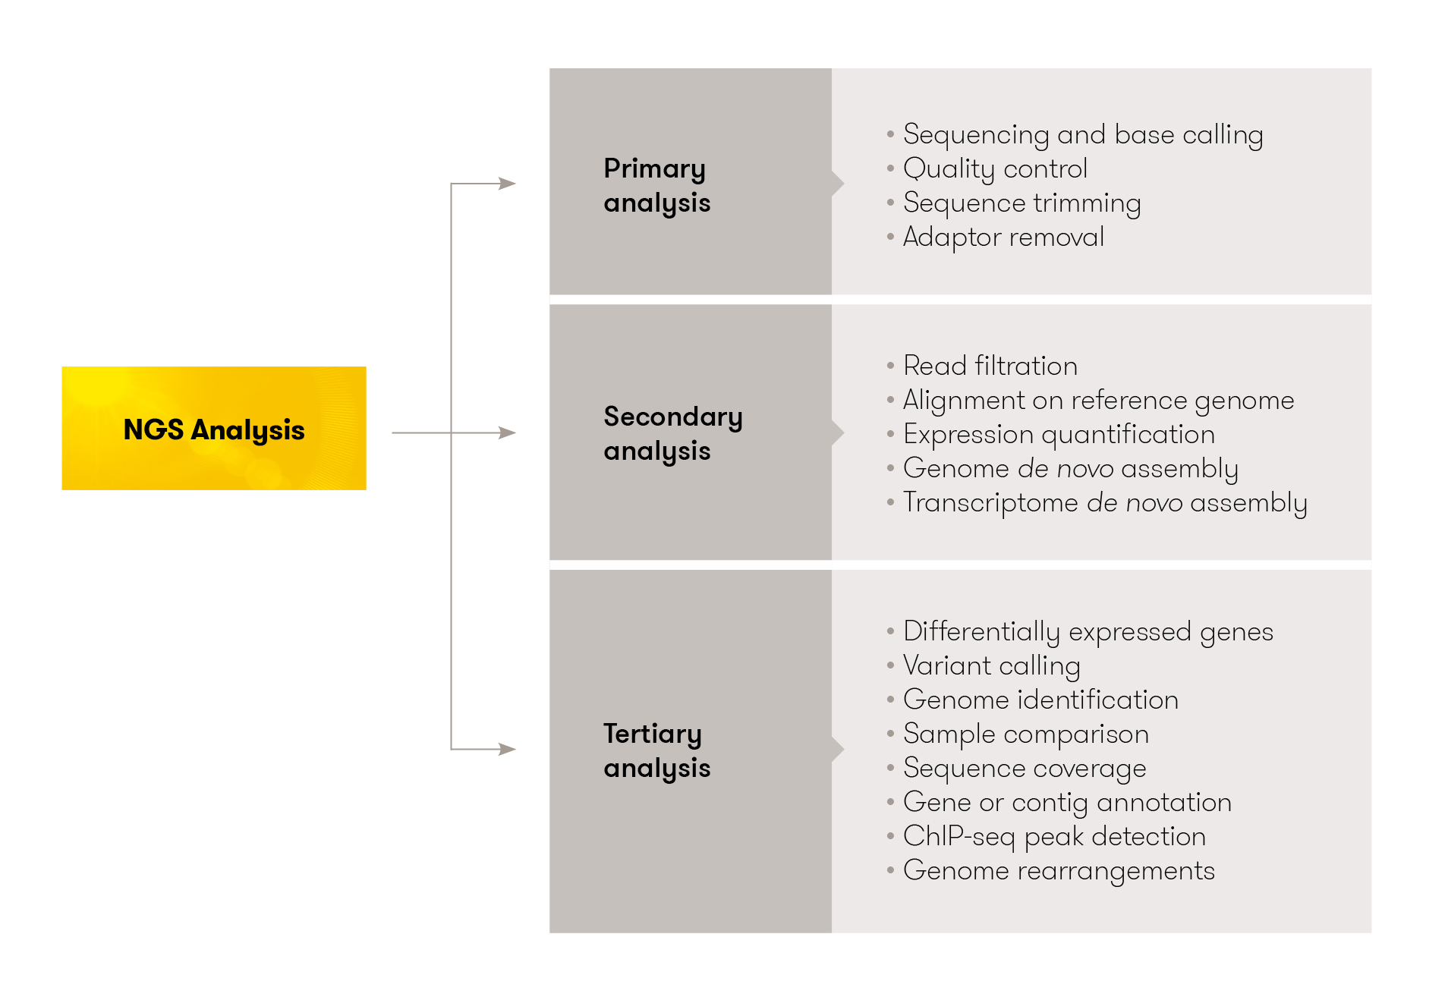
Overview of computational genomic pipelines
https://www.helixio.com/uploads/kcfinder/images/PAGE%20WORKFLOW3.jpg

Slide 7
Overview of computational genomic pipelines
Primary analysis
Mostly handled by software embedded in sequencers
Some Quality Controls (QC) and read trimming may be handled by bioinformaticians
Secondary analysis
De novo assembly
Alignment (also known as mapping)
Multiple Sequence Alignment (MSA)
Expression analysis
Tertiary analysis
Variant calling
Germline versus somatic mutations
Small mutations versus structural variants
Differential Gene Expression (DGE)
Genome Wide Association Studies (GWAS)
Annotations
Pathway analysis

Slide 8
Standard genomic data formats

Slide 9
Why standard genomic data formats?
Data Management: Standard formats facilitate efficient data management, analysis, and interpretation.
Quality Control: They ensure quality control in the production of data.
Comprehensive Reporting: Standard formats promote comprehensive reporting, which is crucial for understanding and replicating the study.
Effective Communication: They aid in effective communication among researchers.
Reproducibility: Standard formats increase the reproducibility of research by making it easier for other researchers to understand and use the data.
Data Sharing and Storage: They support data sharing and storage, which is essential for open science.
It is a requirement for publication in most journals!

Slide 10
Most used data formats in bioinformatics
FASTA: This is a text-based format for representing either nucleotide sequences or peptide sequences, in which nucleotides or amino acids are represented using single-letter codes.
FASTQ: This format is similar to FASTA, but it also includes sequencing qualities.
SAM/BAM: Sequence Alignment/Map (SAM) is a text-based format that stores large numbers of sequences aligned to a reference. Binary Alignment/Map (BAM) is the binary version of SAM.
CRAM: a alternative to SAM/BAM that offer a greater compression rate with lossy or loss-less options
VCF: Variant Call Format (VCF) is a text file format for storing gene sequence variations.
BCF: the binary option of VCF
GFF/GTF: General Feature Format (GFF) and Gene Transfer Format (GTF) are used to store genes and other features associated with DNA, RNA, and protein sequences.
BED: The Browser Extensible Data (BED) format is a flexible way to define data lines that are displayed in an annotation track.
PDB: The Protein Data Bank (PDB) format provides a standard for files containing atomic coordinates.
GEO: The Gene Expression Omnibus (GEO) is a public functional genomics data repository supporting MIAME-compliant data submissions.
SRA: The Sequence Read Archive (SRA) stores raw sequencing data from the next generation of sequencing platforms.

Slide 11
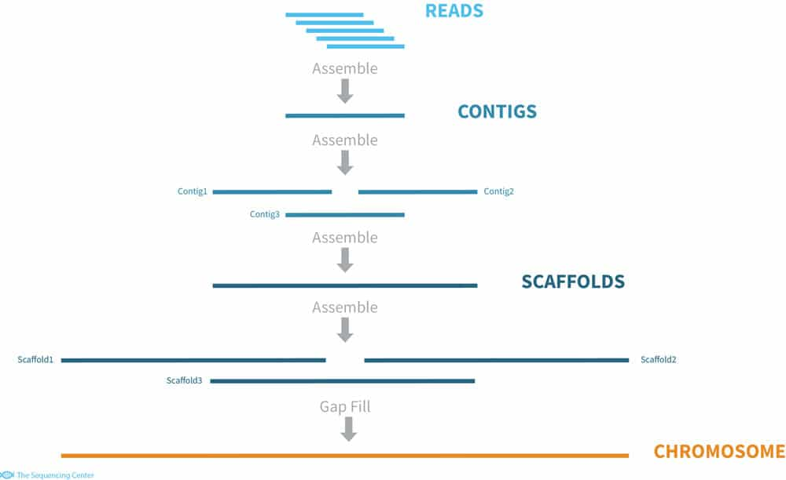
Computational genomic pipelines - assembly
A genome assembly is the computational representation of genome sequence
Given the output short reads of a NGS sequencer, we want to piece them together without context (notice how this is fundamental to build up a genome reference!)
This is also called de novo assembly, which is the same problem that was faced with Edmon’s peptides sequences; and it is the same problem the Human genome Project faced
Nowadays, if you work on human or model organisms (eg: mouse, C. elegans, etc.) you will work with pre-existing reference genomes. This is though key for the analysis of infectious organisms and metagenomics
SPAdes (Bankevich, 2012) is a popular tool for de novo assembly
https://thesequencingcenter.com/wp-content/uploads/2019/01/denovo_assembly.jpg
Standard input: FASTQ Standard output: FASTA

Slide 12
FASTA format
It may contain amino acid, DNA or RNA sequences
The reference genome is represented in a FASTA file with one sequence per chromosome
Possible format extensions: .fasta, .fna, .ffn, .faa, .frn, .fa
>SEQUENCE_1
MTEITAAMVKELRESTGAGMMDCKNALSETNGDFDKAVQLLREKGLGKAAKKADRLAAEG
LVSVKVSDDFTIAAMRPSYLSYEDLDMTFVENEYKALVAELEKENEERRRLKDPNKPEHK
IPQFASRKQLSDAILKEAEEKIKEELKAQGKPEKIWDNIIPGKMNSFIADNSQLDSKLTL
MGQFYVMDDKKTVEQVIAEKEKEFGGKIKIVEFICFEVGEGLEKKTEDFAAEVAAQL
>SEQUENCE_2
SATVSEINSETDFVAKNDQFIALTKDTTAHIQSNSLQSVEELHSSTINGVKFEEYLKSQI
ATIGENLVVRRFATLKAGANGVVNGYIHTNGRVGVVIAAACDSAEVASKSRDLLRQICMH
FASTA format: https://en.wikipedia.org/wiki/FASTA_format

Slide 13
FASTQ format
Represents a raw readout from a sequencer
The first line, starting with `@`, is the sequence identifier.
The second line is the raw sequence letters.
The third line starts with a `+` sign and is optionally followed by the same sequence identifier.
The fourth line encodes the quality values for the sequence in line 2, and must contain the same number of symbols as letters in the sequence.
The quality scores are Phred +33 encoded, using ASCII characters to represent the numerical quality scores. This means that each character represents a probability of error for each base call. For example, an ASCII character of 'A' represents a Phred score of 32, which corresponds to a base call accuracy of 99.94%.
@SEQ_ID
GATTTGGGGTTCAAAGCAGTATCGATCAAATAGTAAATCCATTTGTTCAACTCACAGTTT
+
!''*((((***+))%%%++)(%%%%).1***-+*''))**55CCF>>>>>>CCCCCCC65
FASTQ format: (Cock, 2010)

Slide 14
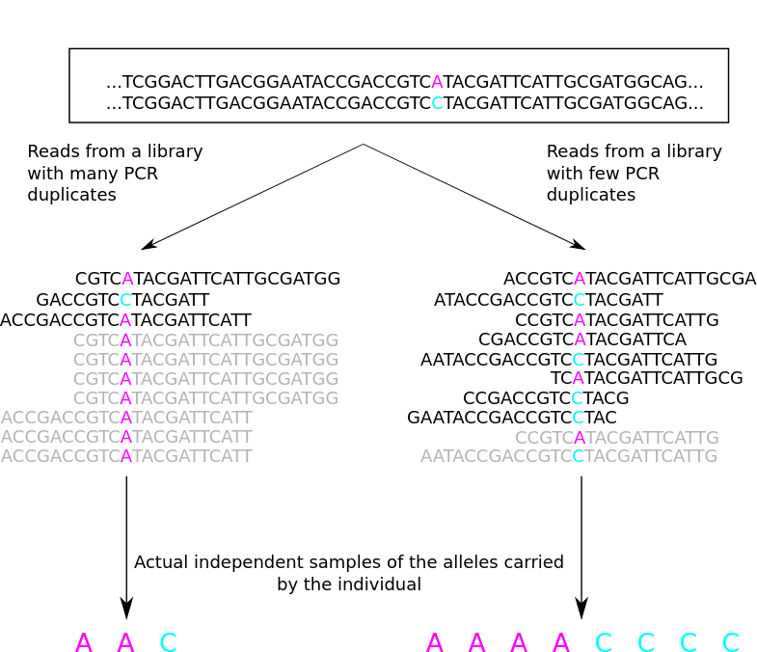
Computational genomics pipelines - alignment
Given the output short reads of a NGS sequencer, we want to piece them together in the context of a reference sequence (notice how this process builds up on the existence of a reference genome!)
In the library preparation there is a step of PCR amplification fundamental to increase the signal for the sequencer.
But PCR amplification is not homogenous across the genome.
Although necessary during DNA preparation, this PCR duplicates have to be detected later on to have an accurate estimation of an individuals genotype (ie: heterozygous or homozygous)
There are different approaches to the alignment process but the tool bwa (Li, 2009) using the Burrows-Wheeler transform and its most efficient evolution bwa 2 (Vasimuddin, 2019) are commonly used.
Standard input: FASTQ Standard output: SAM/BAM
https://eriqande.github.io/eca-bioinf-handbook/figs/pcr-duplicates.svg

Slide 15
SAM/BAM format
Represents the alignment of a read to a reference genome
It provides among other things:
the coordinates where the read is mapped in the reference
the mapping quality (MQ)
CIGAR string that encodes if the mapping contains insertions or deletions
@HD VN:1.5 SO:coordinate
@SQ SN:chr22 LN:1000000
r001 99 chr22 7 30 8M2I4M1D3M = 37 39 TTAGATAAAGGATACTG *
r002 0 chr22 9 30 3S6M1P1I4M * 0 0 AAAAGATAAGGATA *
r003 0 chr22 9 30 5S6M * 0 0 GCCTAAGCTAA * SA:Z:ref,29,-,6H5M,17,0;
r004 0 chr22 16 30 6M14N5M * 0 0 ATAGCTTCAGC *
SAM/BAM format specification: https://samtools.github.io/hts-specs/SAMv1.pdf

Slide 16
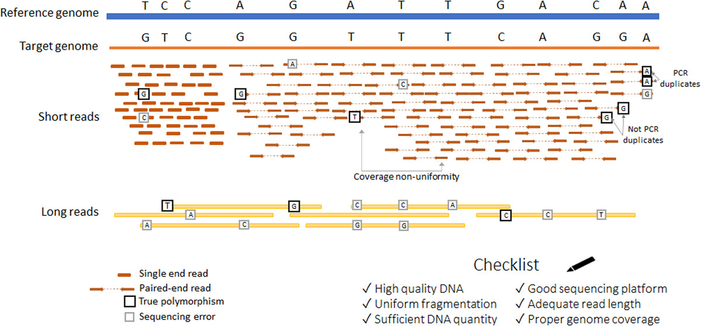
Computational genomics pipelines - variant calling (small and germline)
Given a set of aligned reads (allowing mismatches!) we aim to identify those position that do not match the reference genome (ie: mutations) and their genotype (ie: homozygous or heterozygous)
Challenges:
The sequencing error rate in NGS is not negligible (0.24 ± 0.06% per base (Pfeiffer, 2018)) and is not homogenous across the genome
The long read sequencing error rate is much higher (10-12 % (Morisse, 2021))
In short read sequencing there are PCR duplicates that need to be handled
In diploid organisms, the patterns of homozygous and heterozygous positions are different
There are also PCR enrichment and alignment errors
The genome contain repetitive sequences larger than the read lenght
The reference genome is a chimeric sequence not accurately representing most human populations
The standard variant calling process aims to capture germline mutations in the DNA.
This can also be applicable to families, hence mendelian inheritance can help further categorize mutations into inherited or novel
But there are also approaches to capture mutations in RNA and somatic mutations in tumor-normal pairs
Applications:
Diagnostic of rare diseases
Neonatal screening
Oncological treatment or clinical trial recruitment
Direct-To-Consumer genetics
Research on disease etiology
Figure 1 from https://doi.org/10.1002/humu.24311 (Zverinova, 2021)
Standard input: SAM/BAM Standard output: VCF

Slide 17
VCF format
Represent genomic mutations
Mostly used for Single Nucleotide Variants (SNVs) and small indels (< 50 bp)
Also supports Structural Variants (SVs) incuding large indels, translocations, duplications, inversions, fusions and Copy Number Variants (CNVs)
Every mutation may be annotated at two levels
INFO: mutation annotations (eg: amino acid change)
FORMAT: mutation observation annotation (eg: number of supporting reads)
Also contains metadata in lines preceded by ##
VCFs may hold the mutations of single individual, a family or a large cohort. This make the format flexible enough to cover a wide range of use cases in research and clinical practice
Most variant callers provide their output in VCF format (ie: GATK, Strelka, LoFreq)
Several tools exist for handling of VCFs:
The most used these days is BCFtools (Danecek, 2021) https://samtools.github.io/bcftools/bcftools.html
VCFtools is an older but also popular choice
The binary version of VCF is called Binary Variant Call Format (BCF)
VCF format specification: http://samtools.github.io/hts-specs/VCFv4.4.pdf

Slide 18
VCF format - representing SNVs and small indels
##fileformat=VCFv4.4
##fileDate=20090805
##source=myImputationProgramV3.1
##reference=file:///seq/references/1000GenomesPilot-NCBI36.fasta
##contig=<ID=20,length=62435964,assembly=B36,md5=f126cdf8a6e0c7f379d618ff66beb2da,species="Homo sapiens",taxonomy=x>
##phasing=partial
##INFO=<ID=NS,Number=1,Type=Integer,Description="Number of Samples With Data">
##INFO=<ID=DP,Number=1,Type=Integer,Description="Total Depth">
##INFO=<ID=AF,Number=A,Type=Float,Description="Allele Frequency">
##INFO=<ID=AA,Number=1,Type=String,Description="Ancestral Allele">
##INFO=<ID=DB,Number=0,Type=Flag,Description="dbSNP membership, build 129">
##INFO=<ID=H2,Number=0,Type=Flag,Description="HapMap2 membership">
##FILTER=<ID=q10,Description="Quality below 10">
##FILTER=<ID=s50,Description="Less than 50% of samples have data">
##FORMAT=<ID=GT,Number=1,Type=String,Description="Genotype">
##FORMAT=<ID=GQ,Number=1,Type=Integer,Description="Genotype Quality">
##FORMAT=<ID=DP,Number=1,Type=Integer,Description="Read Depth">
##FORMAT=<ID=HQ,Number=2,Type=Integer,Description="Haplotype Quality">
#CHROM POS ID REF ALT QUAL FILTER INFO FORMAT NA00001 NA00002 NA00003
20 14370 rs6054257 G A 29 PASS NS=3;DP=14;AF=0.5;DB;H2 GT:GQ:DP:HQ 0|0:48:1:51,51 1|0:48:8:51,51 1/1:43:5:.,.
20 17330 . T A 3 q10 NS=3;DP=11;AF=0.017 GT:GQ:DP:HQ 0|0:49:3:58,50 0|1:3:5:65,3 0/0:41:3
20 1110696 rs6040355 A G,T 67 PASS NS=2;DP=10;AF=0.333,0.667;AA=T;DB GT:GQ:DP:HQ 1|2:21:6:23,27 2|1:2:0:18,2 2/2:35:4
20 1230237 . T . 47 PASS NS=3;DP=13;AA=T GT:GQ:DP:HQ 0|0:54:7:56,60 0|0:48:4:51,51 0/0:61:2
20 1234567 microsat1 GTC G,GTCT 50 PASS NS=3;DP=9;AA=G GT:GQ:DP 0/1:35:4 0/2:17:2 1/1:40:3
VCF format specification: http://samtools.github.io/hts-specs/VCFv4.4.pdf

Slide 19
Indexing files with genomic coordinates
Genomic files may be large
WES BAM with 40x may be around 6 GB
WGS BAM with 40x may be around 100 GB
VCFs, BEDs and other formats may also be large when aggregated
BAM binary files have their own indexing method
For other tab-separated files there is bgzip compression and tabix (Li, 2011) that can create an index on genomic coordinates over an arbitrary set of columns based on the same method as BAM files
Indexes allow you to retrieve the content from any genomic region efficiently
tabix all_tmp.bed.gz chr7:5566000-5570500

Slide 20
VCF format - demo
Will follow part of this manual: https://eriqande.github.io/eca-bioinf-handbook/basic-handling-of-vcf-files.html

Slide 21
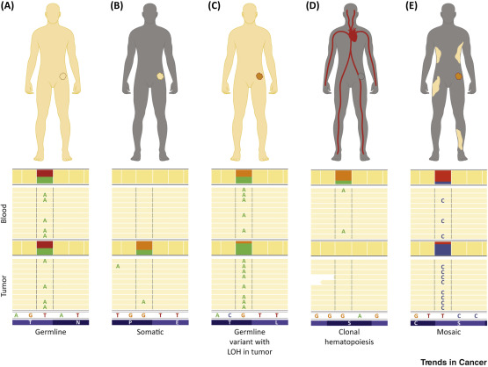
Computational genomics pipelines - variant calling (small and somatic)
Given a set of aligned reads (allowing mismatches!) we aim to identify those position that do not match the reference genome (ie: mutations) in a tumor sample as compared to a normal tissue sample
Challenges (same as germline variant calling plus...):
The cells in a tumor evolve very fast, hence a tumor sample may contain subclones. This implies that the observed range of Variant Allele Frequencies (VAFs) is much wider
Tumor samples may be contaminated by non tumor cells due to imperfect sampling or tumor infiltration of immune cells
The aim is to capture somatic mutations in the tumor DNA
This can also be applicable to multiple tumor samples (eg: primary, metastasis, relapse)
Biological mechanisms
Estochastic accumulation through time, increased by exposure to mutagenic substances
Kataegis describes a pattern of localized hypermutations identified in some cancer genomes, in which a large number of highly patterned basepair mutations occur in a small region of DNA.
Applications:
Oncological treatment or clinical trial recruitment
Personalized cancer vaccines
Research in driver/passenger mutations
Figure 2 from https://doi.org/10.1016/j.trecan.2019.11.006 (Mandelker, 2019)
Standard input: SAM/BAM Standard output: VCF

Slide 22
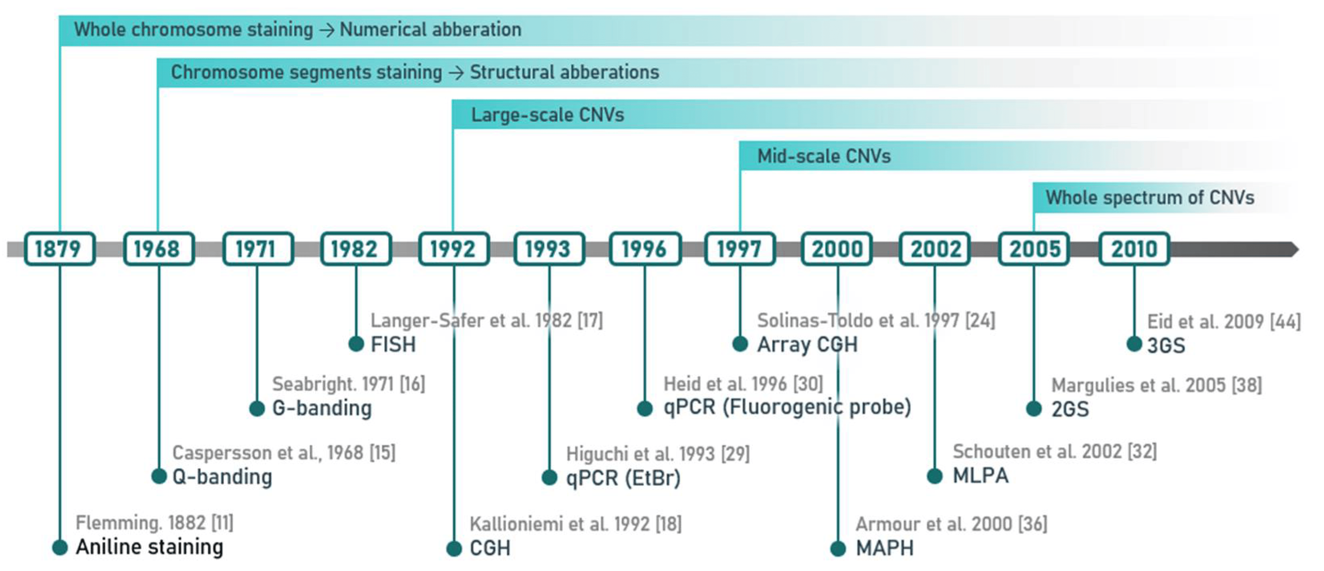
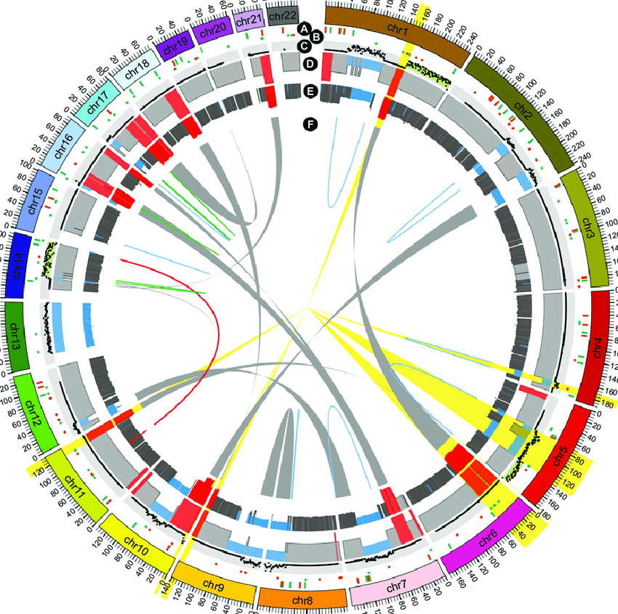
Computational genomics pipelines - variant calling (structural variants)
Standard input: SAM/BAM Standard output: VCF (?)
There are methods based on short reads, but long reads are better suited to structural variant calling
Challenges:
Structural variants are by definition larger than the usual read length, hence their observation is scattered across multiple reads
The coverage of some NGS methods (ie: WES and targeted sequencing) is not homogenous across the genome. On the other hand WGS has a more homogeneous coverage
Due to the large scale impact, these mutations push the boundaries of the use of an imperfect reference genome. Personalized genome assemblies solutions may help interpret and identify these better
Applications:
Same as specified before
With the notable exception of CNVs that have a long history, there is in general less reliability in these methods and their application is more limited
Figure 1 from https://doi.org/10.3390/app11020819 (Pös, 2021)
Figure 2 from https://doi.org/10.1073/pnas.1418577112 (Gupta, 2014)

Slide 23
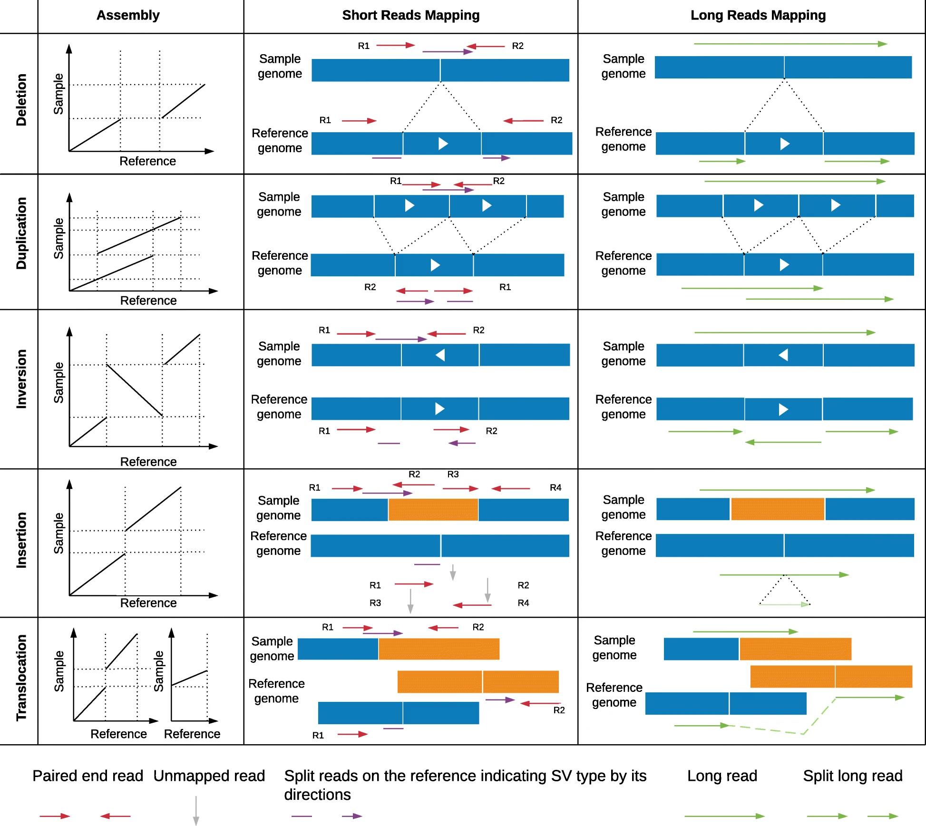
Computational genomics pipelines - variant calling (structural variants)
The structural variants are very diverse in their nature and they require dedicated algorithms for their detection
Large indels
Copy Number Variants (CNVs)
Gene fusions
Translocations
Inversions
Chromosomal rearrangement
Biological events
Chromothripsis is a process in which hundreds to thousands of clustered chromosomal rearrangements occur in a single event in a confined genomic regions in one or a several chromosomes
Figure 1 from https://doi.org/10.1186/s13059-019-1828-7 (Mahmoud, 2019)

Slide 24
VCF format - representing Structural Variants
##fileformat=VCFv4.4
##ALT=<ID=INV,Description="Inversion">
##ALT=<ID=INS,Description="Insertion">
##ALT=<ID=DUP,Description="Duplication">
##ALT=<ID=DUP:TANDEM,Description="Tandem Duplication">
##ALT=<ID=DEL,Description="Deletion">
##ALT=<ID=CNV,Description="Copy number variable region">
##INFO=<ID=MATEID,Number=A,Type=String,Description="ID of mate breakend">
##INFO=<ID=END,Number=1,Type=Integer,Description="End position of the longest variant described in this record">
##INFO=<ID=CIPOS,Number=.,Type=Integer,Description="Confidence interval around POS for symbolic structural variants">
##INFO=<ID=SVLEN,Number=A,Type=Integer,Description="Length of structural variant">
##INFO=<ID=CILEN,Number=.,Type=Integer,Description="Confidence interval for the SVLEN field">
##INFO=<ID=EVENT,Number=A,Type=String,Description="ID of associated event">
##INFO=<ID=EVENTTYPE,Number=A,Type=String,Description="Type of associated event">
##INFO=<ID=CN,Number=A,Type=Float,Description="Copy number of CNV/breakpoint">
##INFO=<ID=SVCLAIM,Number=A,Type=String,Description="Claim made by the structural variant call. Valid values are D, J, DJ for abundance, adjacency and both respectively">
##INFO=<ID=IMPRECISE,Number=0,Type=Flag,Description="Imprecise structural variation">
##contig=<ID=chrA,length=1000000>
##FORMAT=<ID=GT,Number=1,Type=String,Description="Genotype">
#CHROM POS ID REF ALT QUAL FILTER INFO FORMAT sample
chrA 2 . TGC T . . EVENT=DEL_seq GT 0/1
chrA 2 . T <DEL> . . SVLEN=2;SVCLAIM=DJ;EVENT=DEL_symbolic;END=4 GT 0/1
chrA 2 delbp1 T T[chrA:5[ . . MATEID=delbp2;EVENT=DEL_split_bp_cn GT 0/1
chrA 2 delbp2 A ]chrA:2]A . . MATEID=delbp1;EVENT=DEL_split_bp_cn GT 0/1
chrA 2 . T <DEL> . . SVLEN=2;SVCLAIM=D;EVENT=DEL_split_bp_cn;END=4 GT 0/1
chrA 5 . G GAAA . . EVENT=homology_seq GT 1/1
chrA 5 . G <DUP> . . SVLEN=3;CIPOS=0,5;EVENT=homology_dup GT 0/1
chrA 14 . T <INS> . . IMPRECISE;SVLEN=100;CILEN=-50,50;CIPOS=-10,10;END=14 GT 0/1
chrA 14 . G .CCCCCCG . . EVENT=single_breakend GT 0/1
VCF format specification: http://samtools.github.io/hts-specs/VCFv4.4.pdf

Slide 25
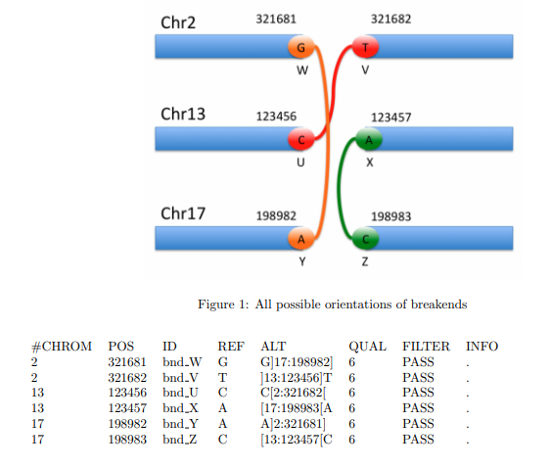
VCF format - illustrating breakends
VCF format specification: http://samtools.github.io/hts-specs/VCFv4.4.pdf

Slide 26
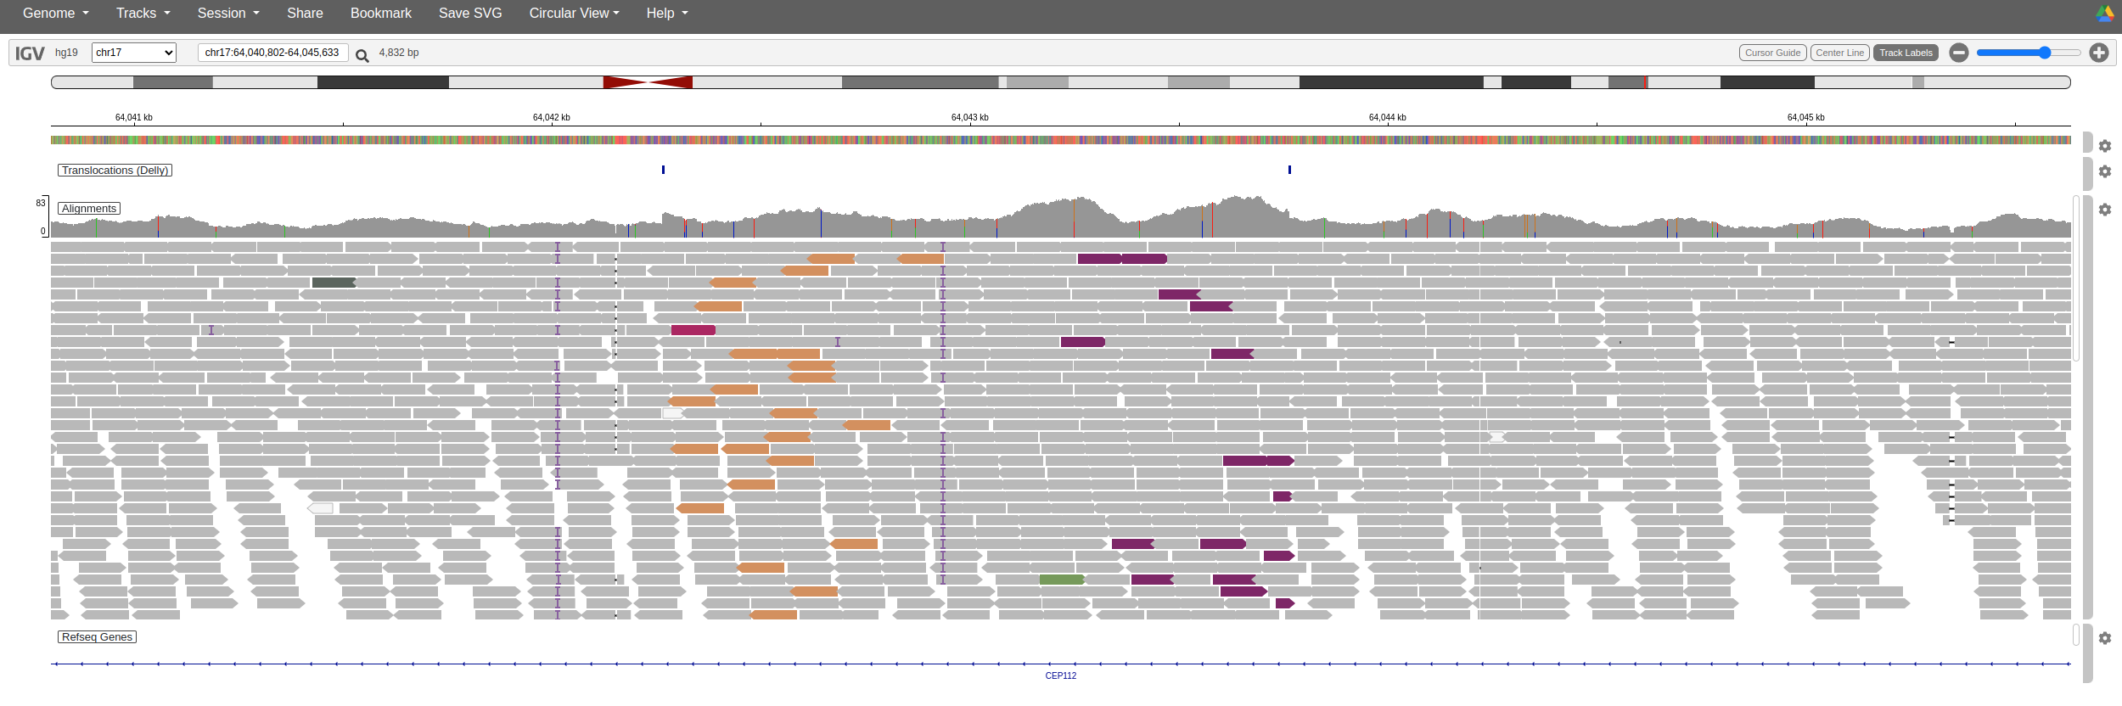
Integrated Genomics Viewer (IGV) - demo

Slide 27
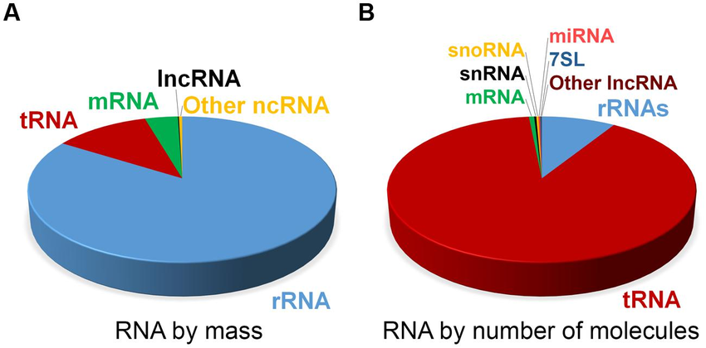
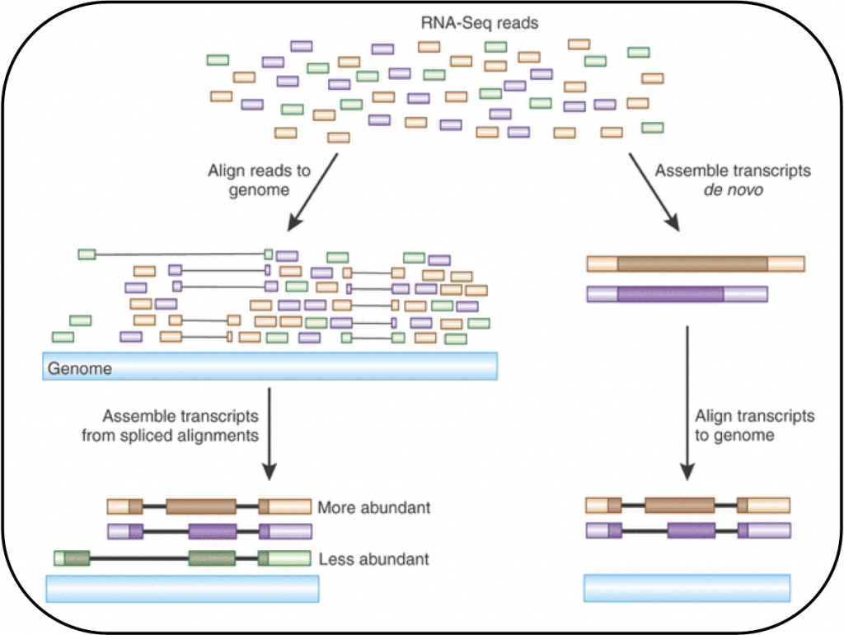
Computational genomics pipelines - RNA alignment
Although the problem is similar RNA alignment has several particularities due to the structure of exons and alternative splicing which makes it more challenging
In fact the tools used for RNA alignment are different, a couple of popular tools are TopHat (Trapnell, 2009), STAR (Dobin, 2013) and Salmon (Patro, 2017)
Source of the image
Standard input: FASTQ + GTF/GFF Standard output: SAM/BAM
https://www.ebi.ac.uk/training/online/courses/functional-genomics-ii-common-technologies-and-data-analysis-methods/

Slide 28
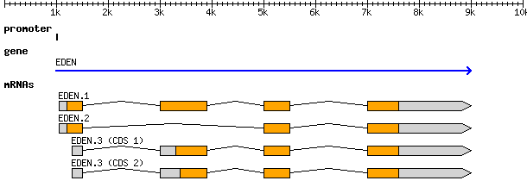
GTF / GFF format
The GTF and GFF aim to represent the structure of genes and transcripts. Although they are similar formats they are not exactly the same, here we will focus in GFFv3
0 ##gff-version 3.1.26
1 ##sequence-region ctg123 1 1497228
2 ctg123 . gene 1000 9000 . + . ID=gene00001;Name=EDEN
3 ctg123 . TF_binding_site 1000 1012 . + . ID=tfbs00001;Parent=gene00001
4 ctg123 . mRNA 1050 9000 . + . ID=mRNA00001;Parent=gene00001;Name=EDEN.1
5 ctg123 . mRNA 1050 9000 . + . ID=mRNA00002;Parent=gene00001;Name=EDEN.2
6 ctg123 . mRNA 1300 9000 . + . ID=mRNA00003;Parent=gene00001;Name=EDEN.3
7 ctg123 . exon 1300 1500 . + . ID=exon00001;Parent=mRNA00003
8 ctg123 . exon 1050 1500 . + . ID=exon00002;Parent=mRNA00001,mRNA00002
9 ctg123 . exon 3000 3902 . + . ID=exon00003;Parent=mRNA00001,mRNA00003
10 ctg123 . exon 5000 5500 . + . ID=exon00004;Parent=mRNA00001,mRNA00002,mRNA00003
11 ctg123 . exon 7000 9000 . + . ID=exon00005;Parent=mRNA00001,mRNA00002,mRNA00003
12 ctg123 . CDS 1201 1500 . + 0 ID=cds00001;Parent=mRNA00001;Name=edenprotein.1
13 ctg123 . CDS 3000 3902 . + 0 ID=cds00001;Parent=mRNA00001;Name=edenprotein.1
14 ctg123 . CDS 5000 5500 . + 0 ID=cds00001;Parent=mRNA00001;Name=edenprotein.1
15 ctg123 . CDS 7000 7600 . + 0 ID=cds00001;Parent=mRNA00001;Name=edenprotein.1
16 ctg123 . CDS 1201 1500 . + 0 ID=cds00002;Parent=mRNA00002;Name=edenprotein.2
17 ctg123 . CDS 5000 5500 . + 0 ID=cds00002;Parent=mRNA00002;Name=edenprotein.2
18 ctg123 . CDS 7000 7600 . + 0 ID=cds00002;Parent=mRNA00002;Name=edenprotein.2
19 ctg123 . CDS 3301 3902 . + 0 ID=cds00003;Parent=mRNA00003;Name=edenprotein.3
20 ctg123 . CDS 5000 5500 . + 1 ID=cds00003;Parent=mRNA00003;Name=edenprotein.3
21 ctg123 . CDS 7000 7600 . + 1 ID=cds00003;Parent=mRNA00003;Name=edenprotein.3
22 ctg123 . CDS 3391 3902 . + 0 ID=cds00004;Parent=mRNA00003;Name=edenprotein.4
23 ctg123 . CDS 5000 5500 . + 1 ID=cds00004;Parent=mRNA00003;Name=edenprotein.4
24 ctg123 . CDS 7000 7600 . + 1 ID=cds00004;Parent=mRNA00003;Name=edenprotein.4
https://github.com/The-Sequence-Ontology/Specifications/blob/master/gff3.md

Slide 29
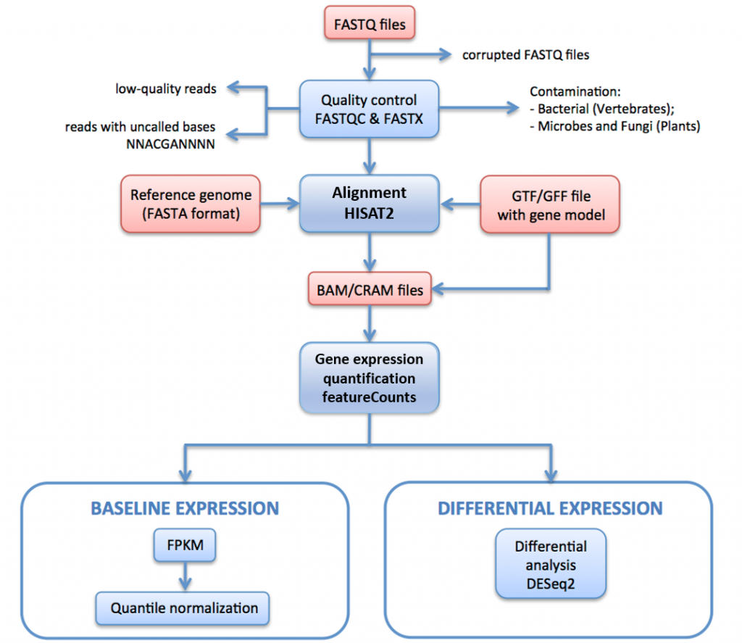
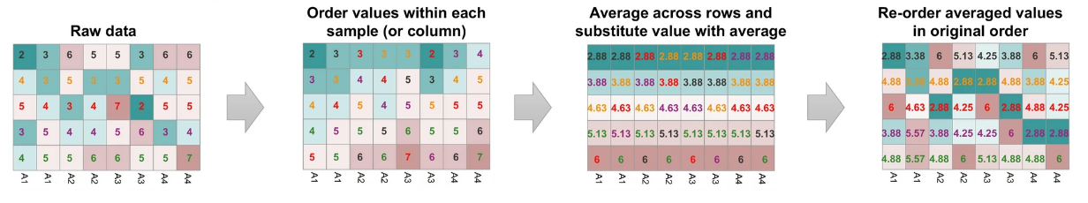
Computational genomics pipelines - gene expression and differential gene expression
Given a set of aligned reads of RNA we aim to quantify the abundance of each gene transcript. Furthermore, given two or more experimental conditions we aim to spot transcripts differentially expressed
Challenges:
Raw read counts are affected by transcript length, ie: longer transcripts have more read counts at equivalent expression levels. This requires a normalization
Comparing expression levels between samples have to account for different library sizes, ie: the absolute number of reads in a sample
The measure RPKM (reads per kilobase of exon model per million reads) and its derivative FPKM (fragments per kilobase of exon model per million reads mapped) and finally TPM (Transcripts per Kilobase Million) normalize read counts into comparable expression levels
RPPKM = read counts / library size / 1,000,000 / gene length, where library size = total reads
TPKM accounts for paired end reads
TPM = read counts / gene length / library size / 1,000,000, where library_size = sum(read counts / gene length)
Quantile normalization introduces a harder normalization method
https://www.ebi.ac.uk/training/online/courses/functional-genomics-ii-common-technologies-and-data-analysis-methods
Standard input: SAM/BAM Standard output: Tables
Figure 1 from (Zhao, 2020) https://doi.org/10.1038/s41598-020-72664-6

Slide 30
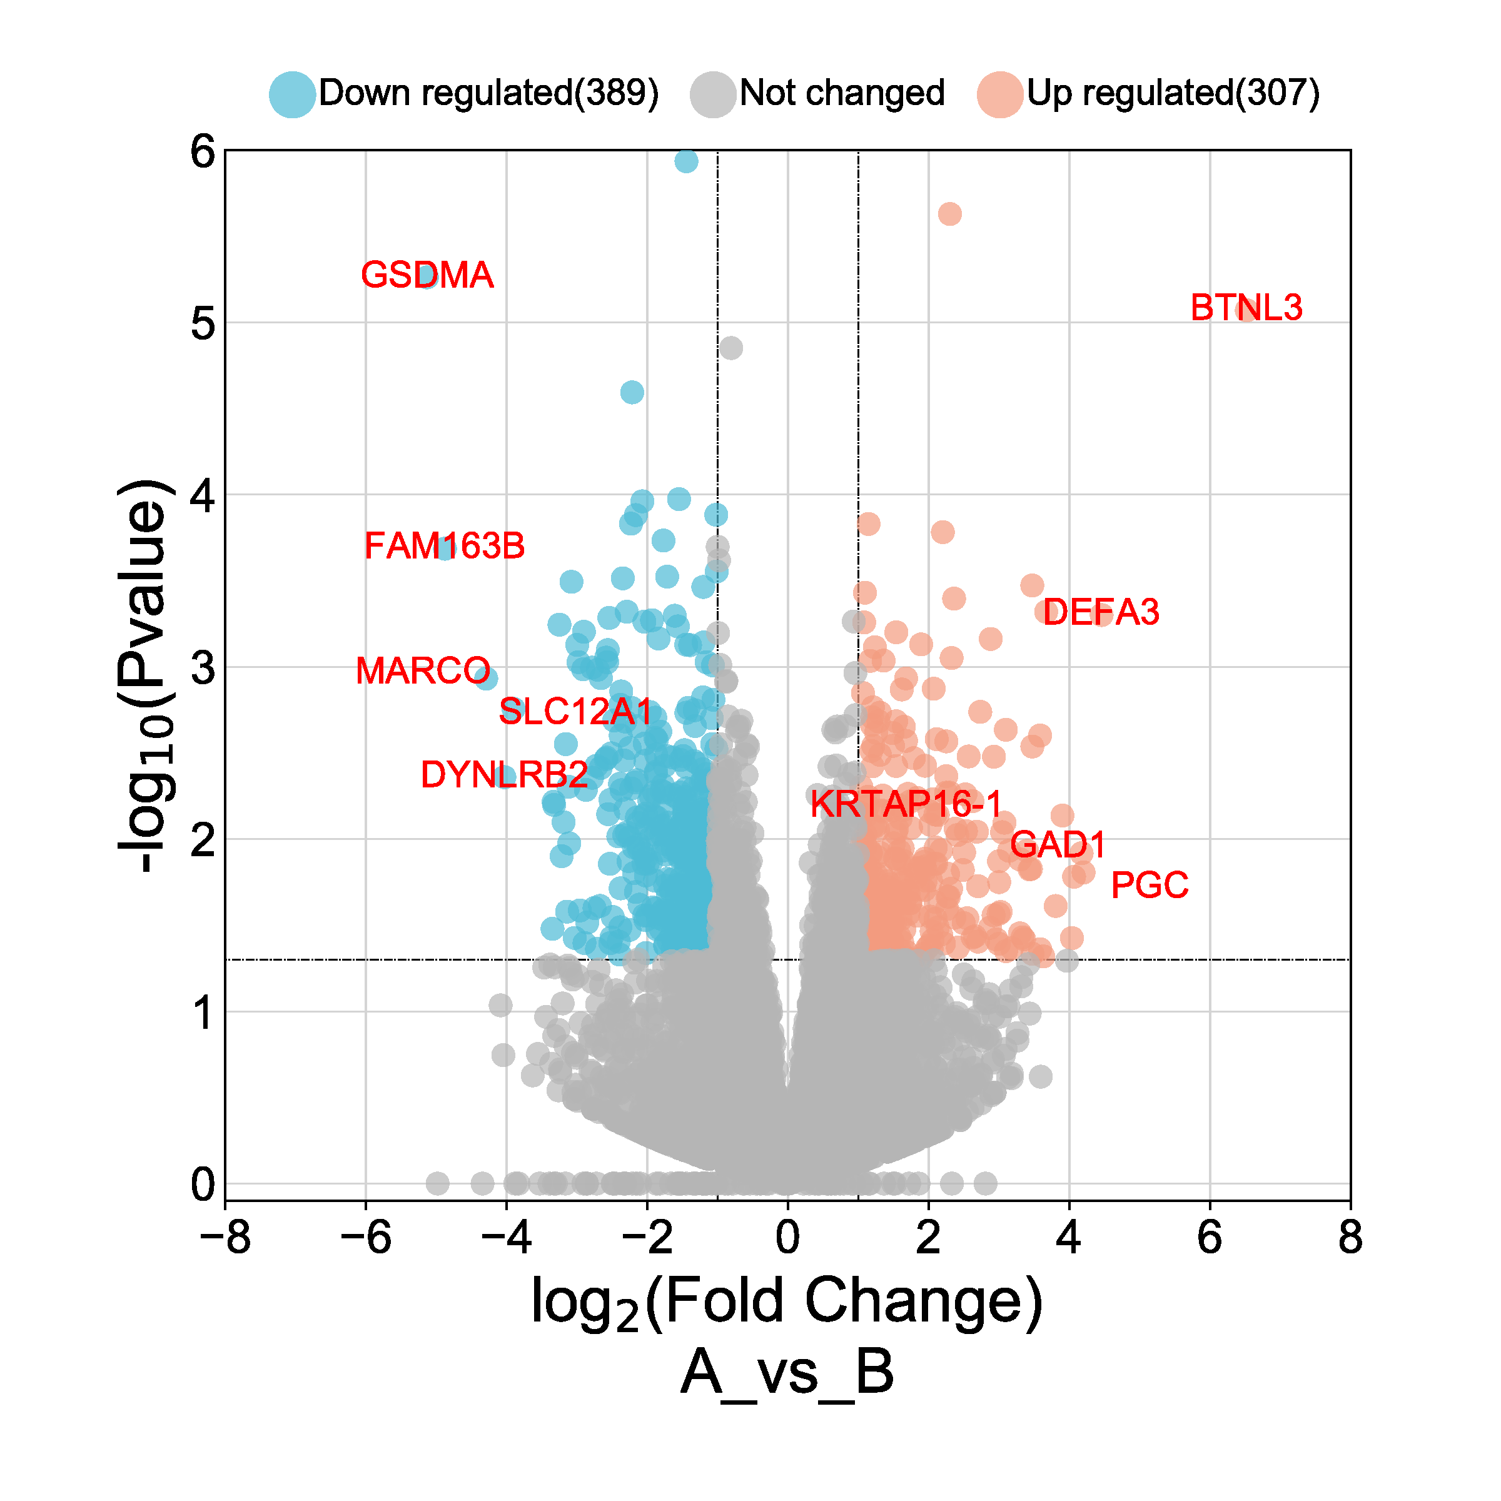
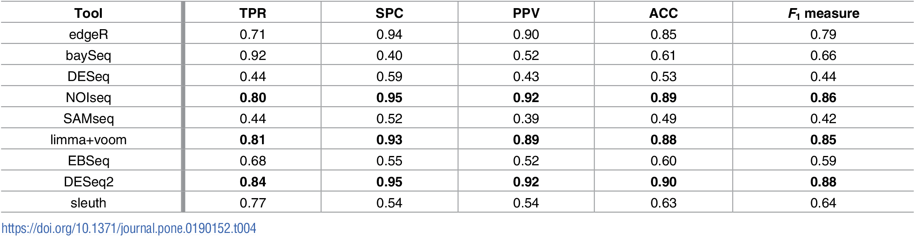
Computational genomics pipelines - gene expression and differential gene expression
In DGE we assess the fold change in each gene between groups in our experimental design. We apply the log transformation to the fold change so both directions of change are represented equally
Furthermore, we want a significance value of the fold change observation.
By setting fold change and significance thresholds we can determine the groups of up and down regulated genes.
There are different statistical methods to detemine the significance, these are based on Bayesian methods, negative binomial and Poisson distributions
https://www.bioinformatics.com.cn/static/img/onlineplots_img/086_basic_3_color_volcano_plot.png

Slide 31
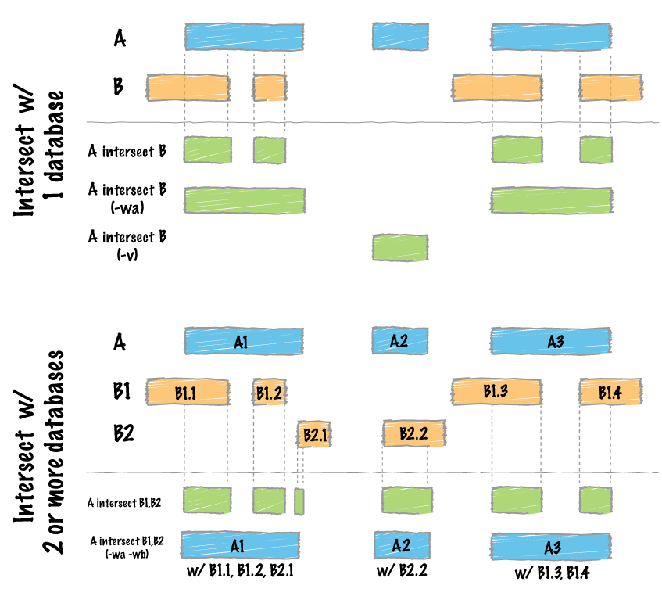
BED and BEDgraph formats
chr1 213941196 213942363
chr1 213942363 213943530
chr1 213943530 213944697
chr2 158364697 158365864
chr2 158365864 158367031
chr3 127477031 127478198
chr3 127478198 127479365
chr3 127479365 127480532
chr3 127480532 127481699
BED
The BED format is simple, it represents genomic intervals. Chromosome, start and end
It is widely used in genome browsers to represent tracks of any arbitrary categorical genomic information, eg: repetitive regions, transcription factors
It may contain additional annotations about how to visualize
The BEDgraph format is similar but aim to support quantitative values associated to the genomic intervals
The reference tool to manipulate BED files is BEDtools (https://bedtools.readthedocs.io/en/latest/)
„the bedtools utilities are a swiss-army knife of tools for a wide-range of genomics analysis tasks. The most widely-used tools enable genome arithmetic: that is, set theory on the genome.“
chr7 127471196 127472363 Pos1 0 + 127471196 127472363 255,0,0
chr7 127472363 127473530 Pos2 0 + 127472363 127473530 255,0,0
chr7 127473530 127474697 Pos3 0 + 127473530 127474697 255,0,0
chr7 127474697 127475864 Pos4 0 + 127474697 127475864 255,0,0
chr7 127475864 127477031 Neg1 0 - 127475864 127477031 0,0,255
chr7 127477031 127478198 Neg2 0 - 127477031 127478198 0,0,255
chr7 127478198 127479365 Neg3 0 - 127478198 127479365 0,0,255
chr7 127479365 127480532 Pos5 0 + 127479365 127480532 255,0,0
chr7 127480532 127481699 Neg4 0 - 127480532 127481699 0,0,255
chr19 49302000 49302300 -1.0
chr19 49302300 49302600 -0.75
chr19 49302600 49302900 -0.50
chr19 49302900 49303200 -0.25
chr19 49303200 49303500 0.0
chr19 49303500 49303800 0.25
chr19 49303800 49304100 0.50
chr19 49304100 49304400 0.75
chr19 49304400 49304700 1.00
BEDgraph

Slide 32
Bibliography and further reading
Kumuthini, J. et al. Ten simple rules for providing effective bioinformatics research support. PLOS Computational Biology 16, e1007531 (2020).
Ma, L. et al. Database Commons: A Catalog of Worldwide Biological Databases. Genomics, Proteomics & Bioinformatics S1672022922001693 (2022) doi:10.1016/j.gpb.2022.12.004.
Amid, C. et al. The European Nucleotide Archive in 2019. Nucleic Acids Research 48, D70–D76 (2020).
Karczewski, K. J. et al. The mutational constraint spectrum quantified from variation in 141,456 humans. Nature 581, 434–443 (2020).
Tate, J. G. et al. COSMIC: the Catalogue Of Somatic Mutations In Cancer. Nucleic Acids Research 47, D941–D947 (2019).
Robinson, J., Halliwell, J. A., McWilliam, H., Lopez, R. & Marsh, S. G. E. IPD—the Immuno Polymorphism Database. Nucleic Acids Research 41, D1234–D1240 (2013).
Vita, R. et al. The Immune Epitope Database (IEDB): 2018 update. Nucleic Acids Research 47, D339–D343 (2019).
Li, H. Tabix: fast retrieval of sequence features from generic TAB-delimited files. Bioinformatics 27, 718–719 (2011).
Li, H. & Durbin, R. Fast and accurate short read alignment with Burrows-Wheeler transform. Bioinformatics 25, 1754–1760 (2009).
Vasimuddin, Md., Misra, S., Li, H. & Aluru, S. Efficient Architecture-Aware Acceleration of BWA-MEM for Multicore Systems. in 2019 IEEE International Parallel and Distributed Processing Symposium (IPDPS) 314–324 (2019). doi:10.1109/IPDPS.2019.00041.
Dobin, A. et al. STAR: ultrafast universal RNA-seq aligner. Bioinformatics 29, 15–21 (2013).
Patro, R., Duggal, G., Love, M. I., Irizarry, R. A. & Kingsford, C. Salmon provides fast and bias-aware quantification of transcript expression. Nat Methods 14, 417–419 (2017).
Cock, P. J. A., Fields, C. J., Goto, N., Heuer, M. L. & Rice, P. M. The Sanger FASTQ file format for sequences with quality scores, and the Solexa/Illumina FASTQ variants. Nucleic Acids Research 38, 1767–1771 (2010).
Danecek, P. et al. Twelve years of SAMtools and BCFtools. GigaScience 10, giab008 (2021).
Bioinformatics Handbook https://eriqande.github.io/eca-bioinf-handbook

